Slide 1
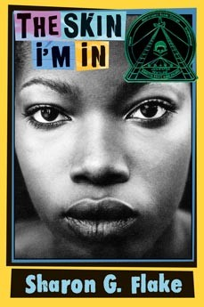
The skin i’m in
By; Sharon g. Flake

Slide 2
Summary
The skin im in is mostly about a girl name Maleeka that gets bullied. Maleeka doesn’t gets bullied because she is ugly or anything else, but she gets bullied cause of her skin. In the beginning of the story Maleeka always gets mad when someone says something about her, but at the end of the story she never cared.

Slide 3
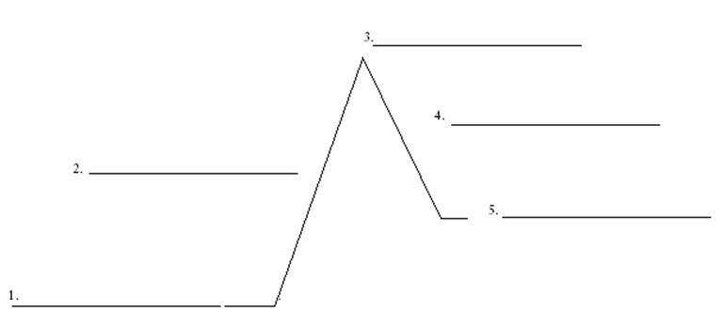
Plot
Maleeka gets in a fight
Maleeka gets suspended
Maleekas classmates make a song about her skin
Maleeka gets in trouble by her mom
Maleeka gets bullied everyday

Slide 4
Setting & tone
The setting of the skin im in is school, class, and home. The author is always positive. According to the book page 45 “when I was walking home”. That explains that Maleeka was going home.

Slide 5
Main character traits, influences, and point of view
Maleeka is a really good person and loves her mom, but sometimes she hangouts with wrong people. Maleeka’s dad passed away so that made it worse for her.

Slide 6
Main conflict
The main conflict in the skin im in is Maleeka get bullied. According to the book page 3 “Maleeka is dark”. That explains that Maleeka gets bullied

Slide 7
Theme #1
One of the themes for the skin im in is don’t worry about what people say. According to the book page 6 Maleeka’s classmates made a song about her.

Slide 8
Theme #2
Another theme is don’t be afraid to talk back to people who bully you. Accoding to the book page 65 “Maleeka walks away”. Maleeka was afraid to talk back.

Slide 9
Theme 3
be respectful to your classmates. According to the book page 95 “Maleeka is a chocolate chip”. That explains that Maleeka’s classmates were being mean to her.

Slide 10
Compare novel to another story
The skin im in can be compared to the running dream because both books are realistic fiction. Another similar thing is both characters get bullied.

Slide 11
Most impactful signpost
The most impactful signpost is tough question. Maleeka said “am I that dark?”. Maleeka always asks herself why do people bully me.

Slide 12
conclusion
The skin im in is mostly about a girl who gets bullied and does bad stuffs, but at the end of the book Maleeka gets good grades and stuff. I would recommend this book to people who like realistic fiction books.

